Slide 1


Project : Indian R ailway Databas e Management S ys tem
A Comprehensive Data Model for Streamlined Railway Operations
Team Members: \[Your Name/Team Name\] | Date: \[Presentation Date\]

Slide 2
Project Overview: Building a Centralized Data Backbone
Our vision is to design and implement a centralized, robust database system for managing the vast and complex operations of the Indian Railways, one of the world's largest rail networks.
Centralize Operations Data
Integrate data streams from passenger services, freight logistics, maintenance, and infrastructure into a single source of truth.
Ensure Data Integrity
Implement robust schema and constraints to improve data quality, consistency, and significantly reduce redundancy across all modules.
Enable Efficient Querying
Facilitate rapid and accurate data retrieval for management decisions, passenger information, and critical maintenance scheduling.
Foundation for Scalability
Provide a future-proof, scalable foundation ready to support
and integrate upcoming digital transformation initiatives.

Slide 3






S ys tem S cope: The S ix Core Operational Modules
The database system is designed to seamlessly integrate and manage the full spectrum of railway operations across these vital areas:
Pas s enger Services
Handling bookings, ticketing, reservations, and real-time passenger information updates.
Train Operations
Managing train master data, real-time schedules, route planning, and occupancy tracking.
Infras tructure Mgt.
Tracking assets like stations, tracks, signals, bridges, and level crossings for
maintenance and safety.
Staff & E ngineering
Employee records, duty rosters, assignment of engineers, and logging
maintenance actions.
Freight & Logis tics
Management of cargo and parcel bookings, tracking, waybills, and logistics movement.
Support Services
Includes catering services, vendor contracts, and the comprehensive handling of customer complaints.

Slide 4
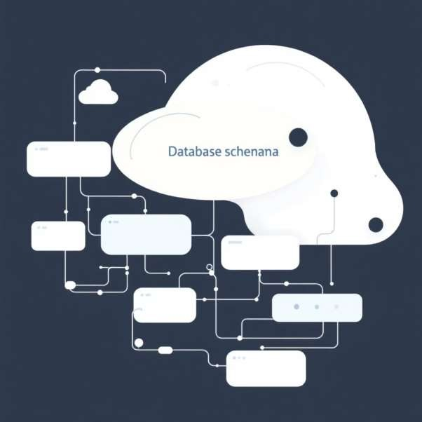
Database Schema Design: Structure for Consistency
Phase 1 focused on developing a highly-normalized relational database schema to ensure data integrity and flexibility for future growth.
Well-Normalized Schema: Designed using third normal form (3NF) principles to minimize data duplication and anomalies.
25 Core Tables: Identified and precisely defined to comprehensively cover all functional areas identified in the scope.
Clear Relationships: The schema establishes explicit, foreign-key enforced relationships between key entities (e.g., Trains to Routes, Passengers to Bookings).
Consistency Guaranteed: This structured approach is vital for supporting
complex transactions and analytical reporting.

Slide 5

High-Level Entity-Relationship Model
This diagram illustrates the critical relationships that form the foundation of our data model, connecting core entities for a seamless operational view.
Routes
Bookings
Passengers
Tickets
Trains

Slide 6
Key Tables Showcase (Part 1): Core Operations
These five tables are essential for the daily management of train movement and customer interaction.
Stations
Data: StationID (PK), Name, Code,
City, PlatformCount.
Trains
Data: TrainID (PK), Number, Name, Source, Destination, Category (e.g., Express, Local).
Passengers
Data: PassengerID (PK), Name,
Contact, ID Proof Type and Number.
Bookings & Tickets
Function: Links Passengers to specific Trains, recording fare, seat details, and booking status.
Routes & Schedules
Function: Defines the path (sequence of stations) and timing (departure/arrival times) for every train journey.

Slide 7
Key Tables S howcas e (Part 2): S upport & Infras tructure
These tables manage the physical assets, logistics, and personnel necessary to keep the railway operational.
Infras tructure As s ets
Tracks, Bridges, Signals, LevelCrossings. Essential for managing rail assets, their location, and condition scores.
Maintenance L ogs
Detailed records of preventative and corrective maintenance on tracks, trains, and signals, linking actions to assigned Engineers.
Staff & Vendors
Manages human resources (Staff ID, Department, Duty Roaster) and contract details for third-party services like Catering.
F reight & Cargo
Dedicated tables for managing Cargo manifests, Parcel tracking, FreightBookings, and customer logistics details.

Slide 8
Data Population and Validation
To move from conceptual design to a functional model, we populated the entire schema with realistic sample data.
25
Total Tables
All identified relational tables
successfully created.
500+
Records Inserted
At least 20 sample records were
inserted into each of the 25 tables.
100%
Validation Rate
Successful validation of all foreign key
constraints and data types.
This data population exercise was critical for testing the table structure, verifying integrity constraints, and demonstrating the efficacy of basic SQL queries in a simulated, real-world scenario (e.g., realistic train names and station data).

Slide 9
Phase-1 Achievements and Basic SQL Proficiency
Phase 1 successfully delivered a fully structured and populated database, ready for advanced querying and analysis.
Database Creation
The
IndianRailway
database instance was successfully initialized and configured.
Schema Definition
All 25 tables were created, including accurate data types, primary keys, and foreign key relationships.
Data Insertion
Sample data was loaded into all tables using
INSERT
commands to confirm schema viability.
SQL Proficiency
Demonstrated foundational command mastery: CREATE, INSERT, SELECT, TRUNCATE, and DROP.
Foundation Ready
A fully structured, validated, and populated database is now operational for the next phase of development.

Slide 10


Next Steps : Roadmap to Advanced Deployment (Phas e-2)
Building on the robust data model established in Phase 1, the next phase will focus on utility, automation, and user interface development.
Advanced Querying
Develop complex SQL joins and aggregated queries to generate actionable business intelligence, such as revenue reports and train occupancy analysis.
S tored Procedures & F unctions
Automate routine tasks like processing new bookings, updating maintenance schedules, and generating system reports directly within the database engine.
F ront-E nd Development
Design and develop a user-friendly application interface (using technologies like Python/Django or Java) to facilitate seamless interaction with the database.
Advanced F eatures
Implement critical functionalities, including secure user authentication, real-time seat availability checks, and scheduled automated report generation.

Slide 11

Indian Railway Management System Phase 2
Database Implementation & Operational Design
Comprehensive Database
Designed for scalable management of all railway operations.
Full CRUD Support
Implementing Create, Read, Update, and Delete across all 25 normalized tables.
Advanced Querying
Enabling complex data analysis for operational insights and optimization.

Slide 12
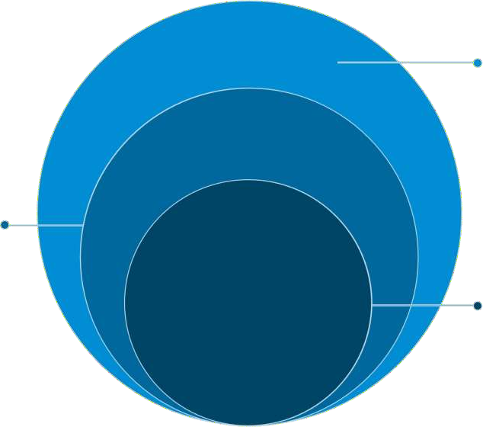
Database Architecture: Multi-Layer Table Structure
Operational Management
Staff, Schedules, Engineers
Transaction Systems
Bookings, Tickets, Payments
Core Entities
Stations, Trains, Passengers, Routes
Our design organizes data into five logical layers to ensure normalization, integrity, and efficient data retrieval, supporting everything from ticketing to
infrastructure maintenance.

Slide 13
Core Pas s enger S ervices Tables
Pas s engers
Personal details, contact information, and mandatory ID verification records for all travelers.
Bookings
Detailed reservation data, payment modes, calculated fares, and seat allocation records.
Tickets
Records for generated e-tickets and counter tickets, including real-time status tracking (Confirmed, Waiting List, Cancelled).
Complaints & Feedback
Structured system for capturing passenger feedback, tracking resolution progress, and analyzing service issues.
Crucially, a relational chain ensures data integrity: Passenger → Booking → Ticket.

Slide 14
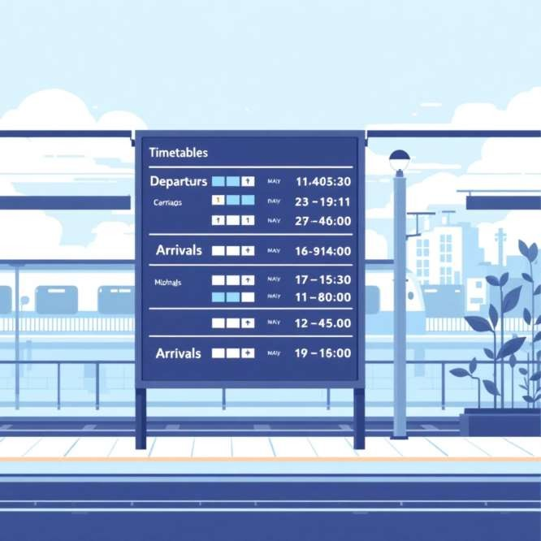
Train Operations and S cheduling
Operational Tables
Trains: Core details, category (Express, Local), and operational running days.
Routes: Defines distance between stations, specified stops, and estimated timing for each segment.
Timetables: Master schedules, frequency metrics, and effective operational periods for train services.
TrainSchedules: Real-time data including actual departures, arrivals, and platform assignments.
Coaches & Seats: Detailed capacity management, seat maps, and real-time availability tracking.

Slide 15





Critical Railway Infrastructure Tracking
Tracks
Section details, gauge type (Broad/Meter), and condition monitoring data derived from sensors and inspections.
Bridges
Structural integrity records, maximum load capacity, and mandated inspection schedules.
Signals
Signal type (e.g., Automatic, Semaphore), geographical locations, and maintenance status logs.
Control Rooms
Centralized operation centers, assigned supervisory staff, and connectivity
details for network management.

Slide 16

S taffing and Maintenanc e S ys tems
Staff Management
Records for all railway personnel, including defined roles, departments, shift schedules, and emergency contact details.
E ngineers and Specialis ts
Tracking of technical specializations, necessary certifications, and real-time maintenance assignment logs.
Maintenance Logs
Comprehensive issue tracking system, detailing actions taken, resolved issues, and dates for the next scheduled maintenance.
Vendor & Service Management
Database for external service providers, including catering contracts, supply chains, and quality assurance metrics.

Slide 17
Cargo and Logistics Management
The goods transportation system handles the entire lifecycle of freight and parcels, from booking to final delivery.
1
2
Cargo
Tracking bulk goods, weight measurements, and detailed station-to-station transfer records for large shipments.
Parcels
Individual parcel tracking, including sender/receiver details, weight class, and specific handling requirements.
3
4
Freight Bookings
Management of commercial freight contracts, rate agreements, and customer billing information.
Key Features
Real-time weight auditing, automated delivery status updates, and predictive delivery date management.

Slide 18

DDL Operations: Databas e S truc ture Management
Database Definition Language (DDL) is used for defining and modifying the database schema, ensuring scalability and integrity of the system.
Table Creation with Cons traints Schema Modific ations
CREATE TABLE Trains ( TrainID INT PRIMARY KEY AUTO_INCREMENT, TrainNumber VARCHAR(10) NOT NULL
UNIQUE -- Additional columns with constraints);
ALTER TABLE Stations ADD COLUMN StationType VARCHAR(50);ALTER TABLE Trains MODIFY COLUMN MaxSpeed INT(5);

Slide 19
DML & DQL Operations: Data Manipulation and Query Examples
Data Manipulation Language (DML)
Used for managing data within the schema objects, enabling day- to-day operations like ticket sales and status updates.
-- Inserting new passengerINSERT INTO Passengers VALUES (...); -- Updating booking statusUPDATE Bookings SET Status = 'Confirmed'; -- Deleting cancelled ticketsDELETE FROM Tickets WHERE Status = 'Cancelled';
Data Query Language (DQL)
Advanced querying for high-level business intelligence and operational reporting.
-- Filtering by performanceSELECT * FROM Trains WHERE MaxSpeed > 120;-- Aggregation and GroupingSELECT StationName, COUNT(*) FROM Stations GROUP BY Zone;-- Subqueries for complex conditionsSELECT * FROM Bookings WHERE Fare > (SELECT AVG(Fare) FROM Bookings);

Slide 20
Advanced Database Features: Constraints and Relationships
Robust constraints are essential for maintaining data integrity and ensuring the reliable operation of the railway system.
Primary Keys
Auto-incremented IDs for all main tables, guaranteeing unique identification for every record.
Foreign Keys
Strictly enforcing referential integrity between linked tables (e.g., Bookings linked to Passengers and Trains).
Unique Constraints
Preventing critical duplicates, such as Train numbers or system-critical user emails.
CASCADE Operations
Configuring automatic updates or deletions in related tables to simplify data maintenance routines.
Data Validation
Utilizing
NOT NULL
and precise data type enforcement to ensure data quality at the point of entry.

Slide 21



Project Overview: Bus Management System
System Overview & Core Objective
The Bus Management System (BMS) is a foundational, comprehensive database designed to centralize and manage all critical aspects of modern bus transportation operations.
Core Project
Bus Management System (BMS)
Primary Goal
Streamline operations and ensure efficient resource allocation.
The system's broad scope includes managing passengers, ticketing, scheduling, staff logistics, and maintenance records.

Slide 22












Database Structure & Key Modules
The BMS is architected as an interconnected system, utilizing distinct modules to manage specialized functions while maintaining data integrity across the platform.
Passenger Management
Customer data, identification, and
history.
Booking & Ticketing
Reservations, issuance, and payment processing.
Support Services
Handling freight, parcels, and
customer feedback.
Bus & Route Management
Defining vehicles, routes, and timetables.
Maintenance
Tracking service history and repair
logs.
Operations & Staff
Driver/conductor assignments and shift scheduling.

Slide 23

Managing Buses and Stations
These two core tables define the physical assets (the buses) and the
operational locations (the stations) that form the logistical backbone of the entire bus network.
Buses Table
BusID, BusNumber, BusName: Unique identifiers and public naming.
Source, Destination: Primary route endpoints.
TotalSeats: Capacity planning for bookings.
Category: Classification (e.g., AC, Sleeper, Executive).
Stations Table
StationID, StationName: Primary identification.
City, State: Geographic location for regional planning.
PlatformCount: Capacity management for scheduling.

Slide 24

Customer and Reservation Hub
Accurate and secure management of passenger data and their associated travel reservations is crucial for regulatory compliance and delivering personalized service.
Passengers Table: Customer Profile
Stores essential customer details for identification and communication.
FirstName, LastName, Age Contact (Phone/Email)
IDProof (Ensures validated traveler identity)
Bookings Table: Reservation Details
Links passengers to specific travel services and tracks payment status.
Links PassengerID to BusID (Foreign Keys)
SeatNumber, JourneyDate Fare (Transaction value)
BookingStatus (Confirmed, Cancelled, Pending)

Slide 25
Organizing Journeys: Routes & Schedules
Precise route planning and schedule adherence are vital for customer satisfaction and operational efficiency. These tables define the movement across the network.
Routes Table
Defines the physical characteristics of the journey.
RouteID
SourceStation, DestinationStation TotalDistance, Duration (For accurate planning)
1
2
BusSchedules Table
Defines the time-bound events of a trip.
ScheduleID, BusID DepartureTime, ArrivalTime
PlatformNumber (Facilitates terminal logistics)
Benefit: The structure ensures buses run on time, minimizing delays and allowing the system to generate real-time, accurate timetables for passengers.

Slide 26
Human Resources & Bus Upkeep
The Operations module integrates staff assignment with vehicle health, ensuring that every scheduled trip is manned by qualified personnel and driven by a safe, reliable vehicle.
Staff Table
Tracks all personnel and their assignments.
MaintenanceLogs Table
Documents all repairs and service requirements.
StaffID, Name
Role (Driver, Conductor, Mechanic)
BusID, Shift (Current assignment details)
LogID, BusID, MechanicID
IssueReported, ActionTaken
NextDueDate (Predictive maintenance scheduling)
Importance: Proper logging ensures vehicle safety, compliance, and proactive service, minimizing unexpected breakdowns.

Slide 27
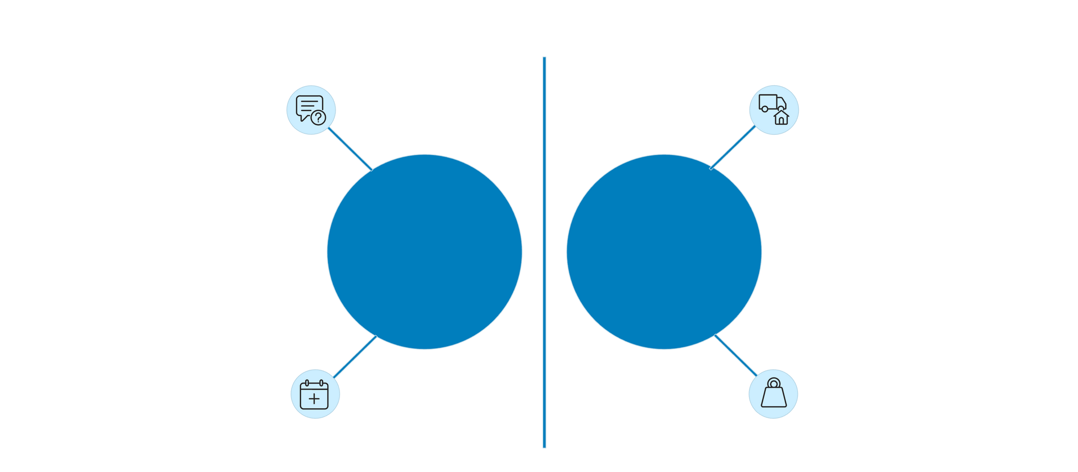




Beyond Passengers: Freight Services
Integrating freight and parcel logistics allows the bus operator to leverage existing routes and vehicles to generate additional revenue streams, diversifying the business model.
BookingID
ParcelID
FreightBookings
Parcels
BookingDate
Weight
FreightBookings Table (Larger Cargo)
FreightID, CustomerName
Parcels Table (Smaller Shipments)
ParcelID, SenderName, ReceiverName

Slide 28

Powerful Queries for Insights
The system's database design enables complex SQL queries, transforming raw transactional data into actionable business intelligence for management.
Aggregate Functions
Calculating key metrics: SUM of revenue, COUNT of bookings, and AVG fare per route.
JOINs & Subqueries
Combining bus and schedule data for complete trip views, and finding the most booked routes.
Window Functions
Using RANK() to segment and sort assets (e.g., buses by maintenance frequency or passenger volume).

Slide 29

Enhancing Functionality with SQL
Beyond standard queries, the use of advanced SQL features like UDFs and Stored Procedures drastically improves system performance and code reusability.
1
2
User-Defined Functions (UDFs)
Encapsulate complex or repeated business logic, such as: fn_discount(Fare) for applying promotions or fn_days_until_maintenance(BusID) for predictive alerts.
Stored Procedures
Manage transactional complexity, ensuring atomicity for multi-step operations like a ticket booking process that updates the Bookings, Seats, and Passenger tables simultaneously.
3
CASE Statements
Implement conditional logic directly in queries. Example: Categorizing bookings as 'High', 'Medium', or 'Low' value based on the Fare amount for rapid analysis.

Slide 30






Delivering Value and Efficiency
The successful implementation of the Bus Management System (BMS) delivers measurable improvements across all organizational functions.
Operational Efficiency
Automated scheduling, maintenance tracking, and streamlined staff assignment reduce manual overhead and errors.
Improved Customer Service
Provides real-time booking status, enables easy complaint logging, and ensures access to accurate trip information.
Data-Driven Decisions
Provides deep insights into popular routes, peak revenue streams, and necessary maintenance investments for strategic planning.
Scalability & Future-Proofing
The robust, modular database design easily accommodates new features such as online payment gateways or dedicated mobile applications.

Slide 31

Project Phoenix:Indian Railway Management System
Phase 4: Integrated Bus Transport System
Project Team: [Your Team Name/Names] | Course: [Your Course Name] | Instructor:
[Your Instructor's Name]

Slide 32
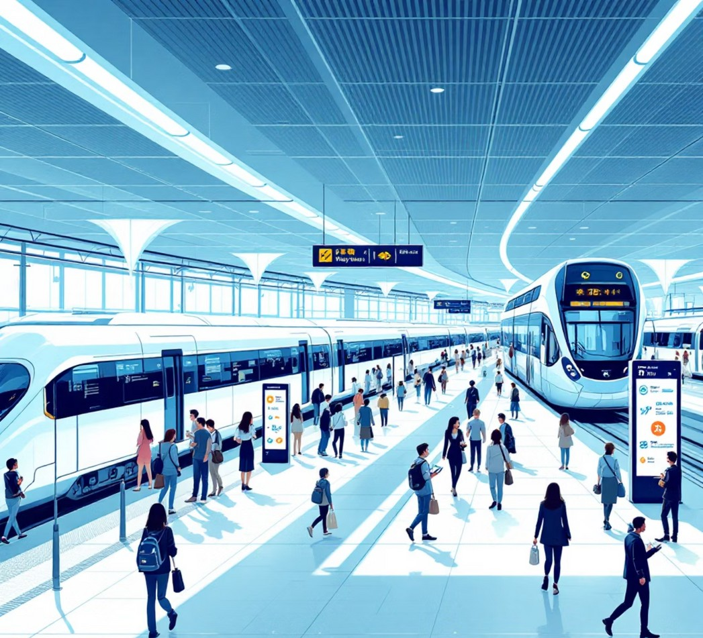

Project Vision & Phase 3 Objective
Project Vision
To create a seamless, multi-modal transportation network under a single, unified management system, connecting diverse travel options for passengers across India.
Phase 3 Objective
To extend the existing railway management infrastructure to incorporate and manage inter-city and feeder bus services. This integration will provide passengers with a unified travel experience, efficiently connecting rail hubs with road transport networks.

Slide 33
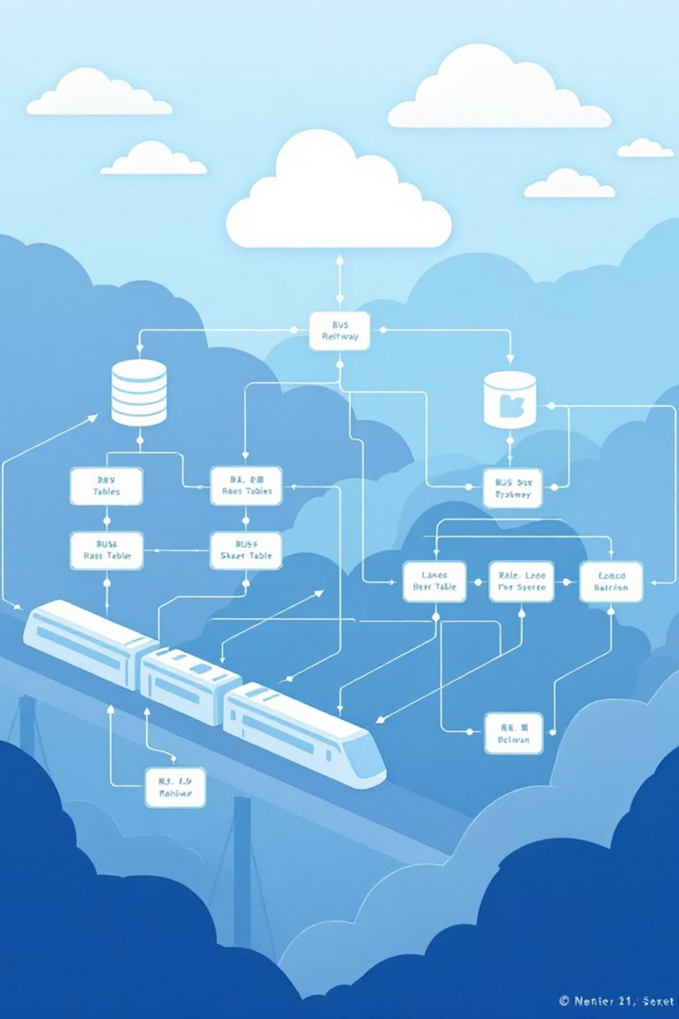
System Architecture Overview
Our system architecture is designed for robustness and scalability, leveraging an integrated database model to unify rail and bus operations.
Integrated Database Model
Leverages the existing, robust Indian Railway database schema. New bus- specific tables are strategically added alongside existing railway tables. Shared tables for Passengers, Bookings, and Staff ensure data consistency and integrity across both modes of transport.
Core Components
Bus Management: Buses, Routes, Schedules
Ticketing & Booking: Integrated with the main system Operations: Bus staff, maintenance, and cargo handling Infrastructure: Bus stands, terminals, and passenger amenities

Slide 34
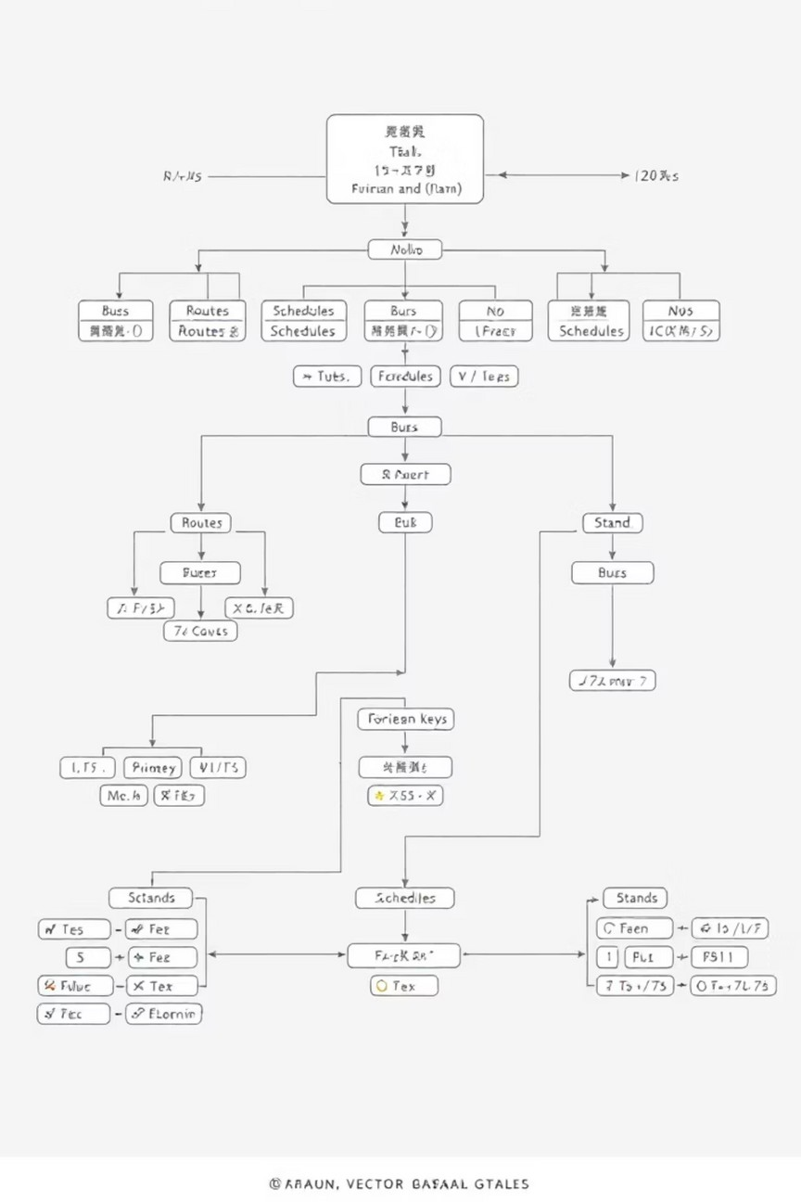




Core Database Tables for Bus System
To seamlessly integrate bus services, we've introduced dedicated tables that mirror the structure and functionality of the existing railway schema.
1. Buses
Attributes: BusID (PK), BusNumber, Capacity, Type (AC, Sleeper, Seater), Status.
Manages detailed information for each vehicle.
2. BusRoutes
Attributes: RouteID (PK), SourceTerminal, DestinationTerminal, Distance, Duration. Defines the specific paths for bus travel.
3. BusSchedules
Attributes: ScheduleID (PK), BusID (FK), RouteID (FK), DepartureTime, ArrivalTime.
Organizes bus movements and timings.
4. BusStands
Attributes: StandID (PK), StandName, City, Facilities (e.g., Waiting Room, Cafeteria). Registers bus stop locations and amenities.

Slide 35

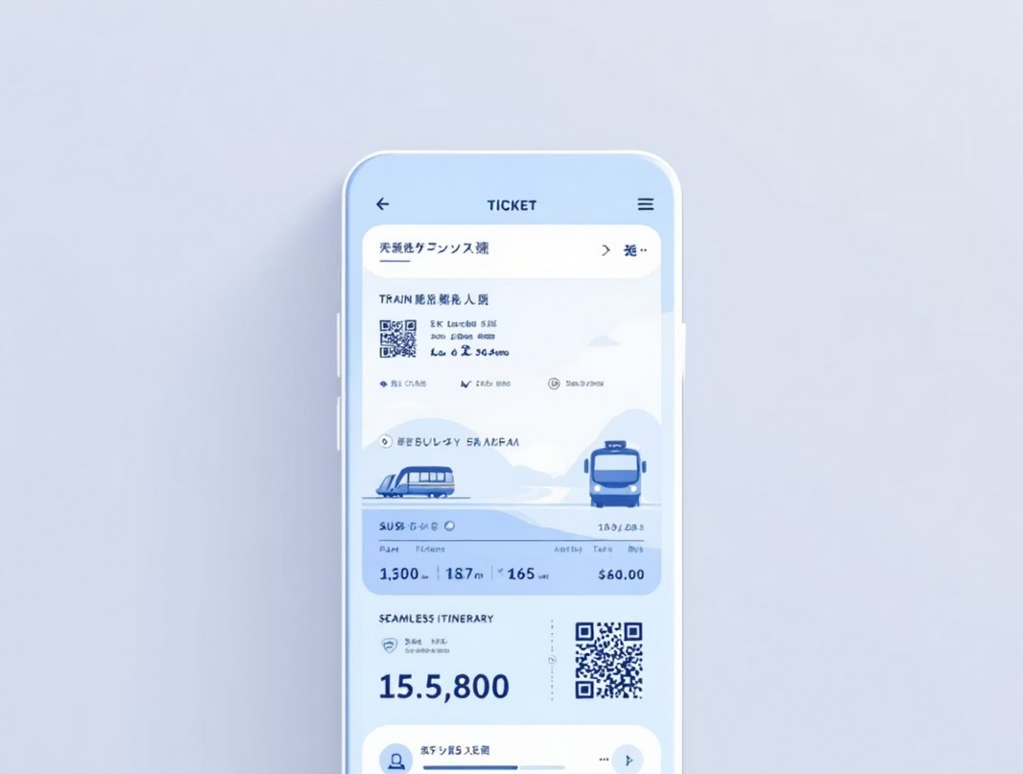
Integrated Booking & Ticketing
The system now offers a unified booking experience, allowing passengers to reserve tickets for both bus and rail seamlessly.
Unified Passenger Experience
Passengers can book combined "Train + Bus" tickets in a single transaction. The Bookings table is extended with a TransportMode column (Train/Bus).
The Tickets table can now generate tickets for both rail and bus journeys, simplifying travel logistics.
Example Query: Passenger Bookings
-- Find all bookings for a passenger including bus journeysSELECT BookingID, JourneyDate, CASE WHEN TransportMode = 'Bus' THEN 'Bus Booking' ELSE 'Train Booking' END as BookingTypeFROM BookingsWHERE PassengerID = 123;

Slide 36




Operational Management Enhancements
Operational efficiency is crucial. Our system extends management capabilities to include bus services, ensuring comprehensive oversight.
Staff Management
Bus Drivers and Attendants are seamlessly integrated into the existing Staff table with a specific Role designation, allowing for centralized human resource management.
Maintenance Logs
The MaintenanceLogs table is now versatile, used for both train and bus upkeep. A VehicleType column (Train/Bus) distinguishes between modes.
Cargo & Parcels
The Parcels and FreightBookings tables have been extended to efficiently handle cargo and parcel services carried by bus, expanding logistical capabilities.

Slide 37










Key Features & Functionalities
The integrated system introduces advanced features designed to enhance user experience and operational effectiveness.
Seamless Transfers
Automatically suggest bus connections for smooth train arrivals.
Real-Time Tracking
View bus locations and estimated arrival times for informed travel.
Dynamic Pricing
Implement fare rules based on demand and bus type for optimized revenue.
Centralized Complaints
Passengers can log issues for any transport mode in one place.
Maintenance Alerts
Automated scheduling for bus servicing based on mileage and usage.

Slide 38
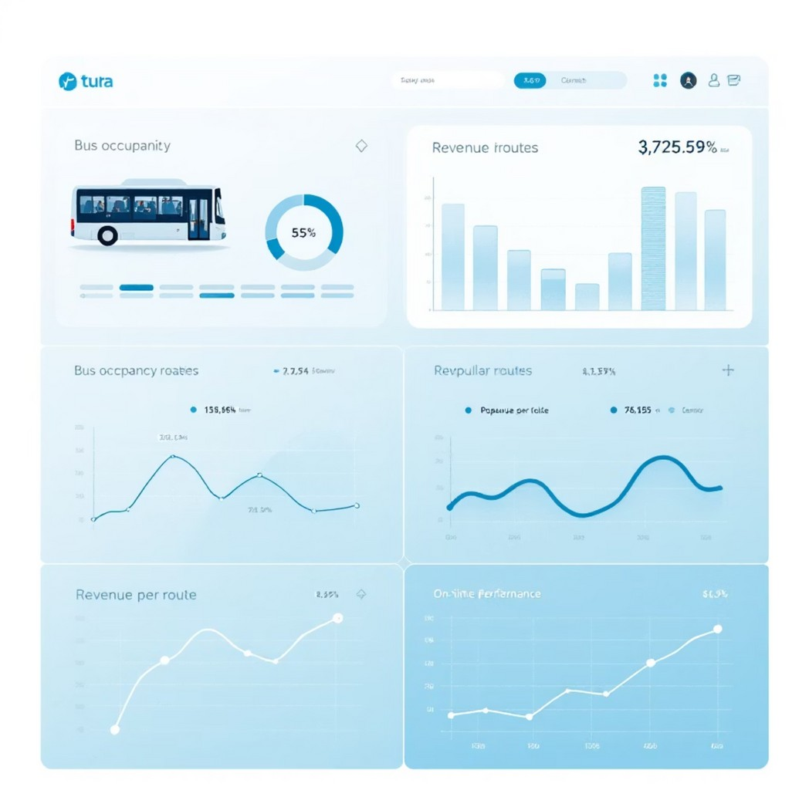
Data Analysis & Reporting
Leveraging the power of SQL, our system provides deep insights for data-driven decision-making.
Leveraging SQL Power
Stored Procedures: E.g., GetBusOccupancy(IN BusID) to calculate daily revenue and passenger load.
Views: E.g., PopularBusRoutes to quickly identify most frequented routes.
Window Functions: Used to rank buses by their on-time performance, improving punctuality.
Aggregate Queries: Analyze passenger load and revenue per route for strategic planning.

Slide 39



Technology Stack & Implementation
Our system relies on a robust and scalable technology stack to ensure reliability and performance.
Database Management System
MySQL: A powerful, open-source relational database.
Stored Procedures & Functions
For complex business logic, such as fare calculation and route optimization.
Triggers
For automatic logging and data integrity (e.g., auto-update seat availability).
Views
To simplify data access and tailor reports for different user roles.
Transactions
Ensuring booking and payment data are committed reliably and securely.

Slide 40


Benefits of the Integrated System
Project Phoenix delivers substantial advantages for both passengers and management, transforming the transportation landscape.
For Passengers
For Management
One-stop shop for multi-modal travel planning and booking.
Smoother connections and simplified travel planning. Consistent and unified user experience across all modes. Enhanced convenience and reduced stress during journeys.
Holistic view of the entire transportation network for better oversight.
Improved resource allocation (buses, staff, maintenance) and operational efficiency.
Data-driven decision-making for optimized route planning and dynamic pricing.
Streamlined operations and significantly reduced administrative overhead.

Slide 41

Project Phase 5: Advanced Database Implementation
Indian Railway Management System
Database Optimization, Automation & Business Logic Implementation

Slide 42

Database Schema Enhancement
Structural Refinements for Scalability
Dynamic Table Management
Created and dropped tables dynamically, such as 'Alerts', to manage transient or situation- specific data efficiently.
Enhanced Data Relationships
Added DriverID to the 'Trains' table, enabling more precise mapping between personnel and active trains for operational clarity.
Optimized Column Structure
Modified column types for better data integrity and storage. Dropped obsolete columns like 'Remarks' from 'Engineers' table, based on operational feedback.
Performance Indexing
Implemented crucial indexes, including idx_train_schedule, to significantly accelerate data retrieval and query execution times.

Slide 43




Data Integrity & Constraints
Enforcing Data Validity and Relationships
Key Constraints
Established PRIMARY KEY and UNIQUE constraints (e.g., Email in 'Passengers') to guarantee data uniqueness and provide efficient record identification.
Validity Checks
Implemented CHECK constraints (e.g., Age > 0) to ensure that only valid data is entered into tables, preventing logical inconsistencies.
Foreign Key Actions
Defined robust foreign keys with specific actions:
ON DELETE CASCADE (Routes → Schedules) ON UPDATE CASCADE (Bookings → Tickets) ON DELETE SET NULL (Trains → Coaches)

Slide 44

Advanced Querying & Analytics
Complex Data Retrieval and Analysis
Relational Data with JOINs: Utilized INNER, LEFT, RIGHT, and SELF JOINs to seamlessly combine data from multiple related tables.
Subqueries for Granular Detail: Employed both nested and correlated subqueries to retrieve data that depends on outer query results, enabling complex filtering and data retrieval scenarios.
Aggregated Insights: Summarized data using SUM, AVG, COUNT, MIN, and MAX functions to derive key performance indicators and statistical insights.
Categorical Analysis: Applied GROUP BY clauses with HAVING conditions to segment and filter aggregated results, providing deep insights into different categories of operational data.

Slide 45



Stored Procedures & Functions
Encapsulating Business Logic
Efficient Code Reusability
1
Reusable Procedures
2
GetTrainsByCategory
AddPassenger
DeletePassengerByID
Scalar Functions
3
UPPER, LOWER
CONCAT, TRIM
LENGTH
Stored procedures streamline common operations, enhance security, and improve performance by compiling execution plans. Scalar functions ensure data consistency and enable complex string or numeric manipulations directly within queries.

Slide 46


Views & Common Table Expressions (CTEs)
Simplifying Data Access and Reusability

Slide 47


Window Functions for Advanced Reporting
Ranking and Time-Based Analysis
Ranking Bookings
ROW_NUMBER() was employed to assign a unique sequential integer to each row within a partition, crucial for sequencing bookings or events.
Train Rankings
RANK() and DENSE_RANK() were used to assign ranks to trains based on specific criteria (e.g., punctuality, passenger volume), handling ties appropriately.
Temporal Comparisons
LEAD() and LAG() enabled comparisons of current row values with values from preceding or succeeding rows within the same result set, ideal for fare adjustments or year-over-year analysis.

Slide 48
Transaction Management
Ensuring Data Consistency and Recovery
Robust transaction management is critical for maintaining data integrity in high-volume systems like the Indian Railway Management System.
Start Transaction
Initiated with START TRANSACTION to define a logical unit of work, ensuring all subsequent operations are treated as a single, atomic operation.
Rollback on Error
Employed ROLLBACK to undo all changes if any part of the transaction fails or encounters an error, restoring the database to its state before the transaction began.
1
2
3
4
Commit Changes
Utilized COMMIT to permanently save all changes made within a transaction to the database, making them visible to other transactions.
Savepoints for Partial Rollback
Implemented SAVEPOINT to allow for partial rollbacks within a larger transaction, providing greater flexibility in error handling and recovery.
This ensures atomic operations, especially for critical processes like booking and ticket issuance, where partial updates are unacceptable.

Slide 49




Triggers for Automated Workflows
Real-Time Data Integrity and Automation
AFTER INSERT
Updates seat availability automatically after a new booking is confirmed, ensuring real-time inventory accuracy.
BEFORE UPDATE
Validates passenger age prior to updating records, enforcing business rules directly at the database level.
AFTER DELETE
Marks a booking as cancelled when its corresponding ticket is deleted, maintaining data synchronization across related entities.
BEFORE INSERT
Ensures that the TrainNumber is never null during the insertion of new train records, guaranteeing essential data presence.

Slide 50
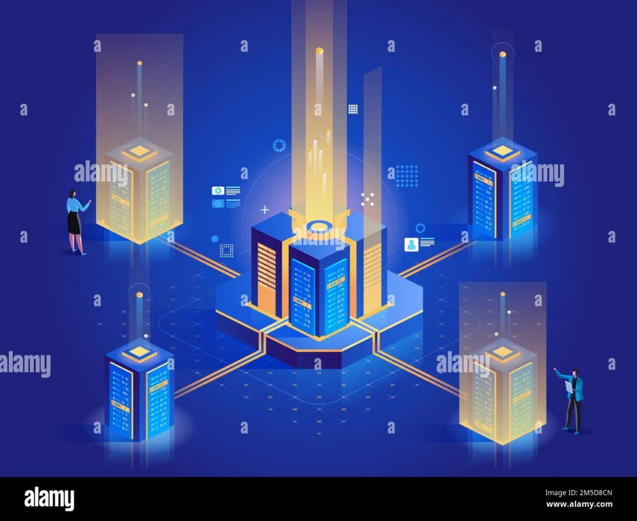
Data Manipulation & Maintenance
Live Data Operations and Cleanup
CRUD Operations: Performed standard INSERT, UPDATE,
and DELETE operations across various tables, managing the lifecycle of railway data.
Batch Updates: Applied efficient batch updates, such as a targeted fare increase for credit card users, minimizing
operational downtime.
Data Cleanup: Conducted regular cleanup operations, including the deletion of cancelled bookings, to optimize database performance and storage.
Referential Integrity: Maintained strict referential integrity rules throughout all data manipulation tasks, especially during deletions, to prevent orphaned records.

Slide 51

Building the Indian Railway Database: A Phased Approach
Our journey into database design began with a meticulously planned, phased approach to construct a robust and efficient system for the Indian Railway. Each phase built upon the last, progressively introducing more complex concepts and functionalities.

Slide 52




Phase 1: Foundation and Schema Design
Schema Establishment
This initial phase was dedicated to laying the groundwork, focusing on the fundamental schema for the Indian Railway database.
25 Distinct Tables
We designed and created 25 unique tables to manage a comprehensive range of data, including stations,
trains, passengers, bookings, cargo, and maintenance logs.
Normalized Structure
The primary objective was to ensure a comprehensive and normalized database structure, minimizing redundancy and maximizing data integrity.

Slide 53
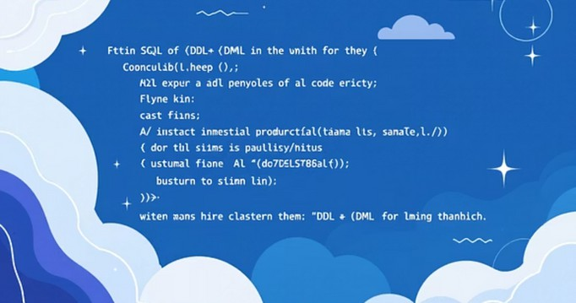


Phase 2 & 3: Data Manipulation and Advanced Queries
Phase 2: Core SQL Application
DDL: Altered table structures to optimize data storage and relationships.
DML: Mastered inserting, updating, and deleting records with precision.
DQL: Retrieved specific information using powerful query techniques.
Constraints & Operators: Implemented for robust data integrity and refined query results.
Phase 3: Advanced Querying
Built-in Functions: Utilized SQL's rich library for data manipulation and analysis.
Subqueries: Crafted complex nested queries for intricate data retrieval.
JOIN Operations: Performed various types of JOINs (INNER, LEFT, RIGHT, FULL) to combine data seamlessly.
User-Defined Functions (UDFs): Created custom logic for efficient and reusable code.

Slide 54
Phase 4 & 5: Advanced Features and System Integration
Phase 4: Advanced Database Functionalities
Views: Created simplified representations of complex queries.
Stored Procedures: Developed reusable code blocks for automation.
Window Functions: Applied for sophisticated analytical tasks and reporting.
Triggers: Implemented automated responses to data modifications.
TCL: Utilized Transaction Control Language for data integrity.
Phase 5: Comprehensive System Demonstration
This culminating phase showcased a full integration of all learned SQL skills:
Table Creation & Data Manipulation: Seamless execution from schema to record management.
Advanced Querying & Joins: Complex data retrieval and inter-table relationships.
Views & Stored Procedures: Efficient data access and automated processes.
Window Functions & Triggers: Sophisticated analytics and automated data responses.
Transaction Management: Ensured data consistency with COMMIT and ROLLBACK.

